Slide 1
Machine Learning
Piyush Dave

Slide 2
Machine Learning is the science (and art) of programming computers so they can learn from data.
Reference:- Hands-On Machine Learning with Scikit-Learn and TensorFlow 2nd Edition by Aurélien Géron

Slide 3
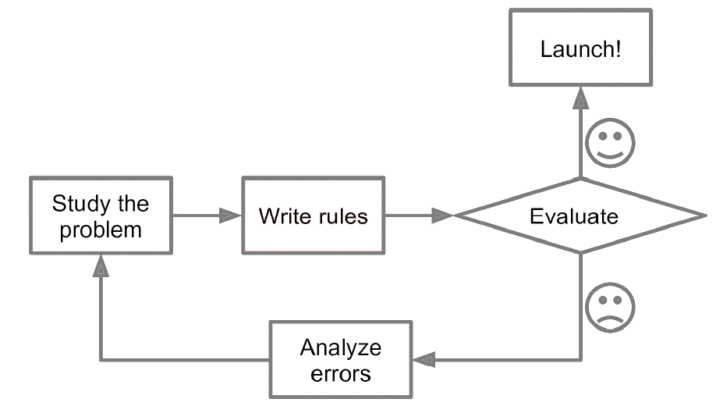

Slide 4
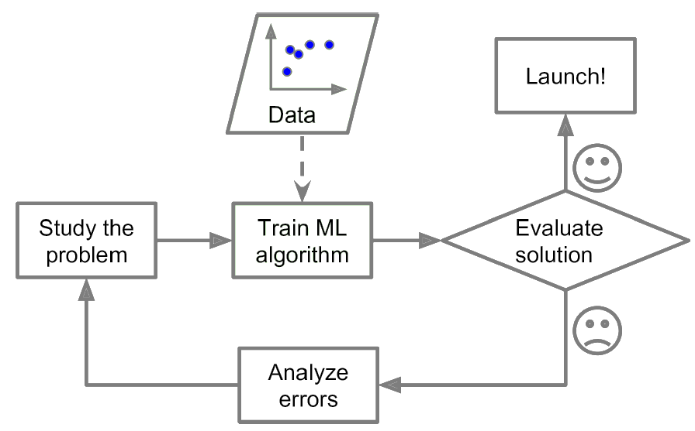

Slide 5
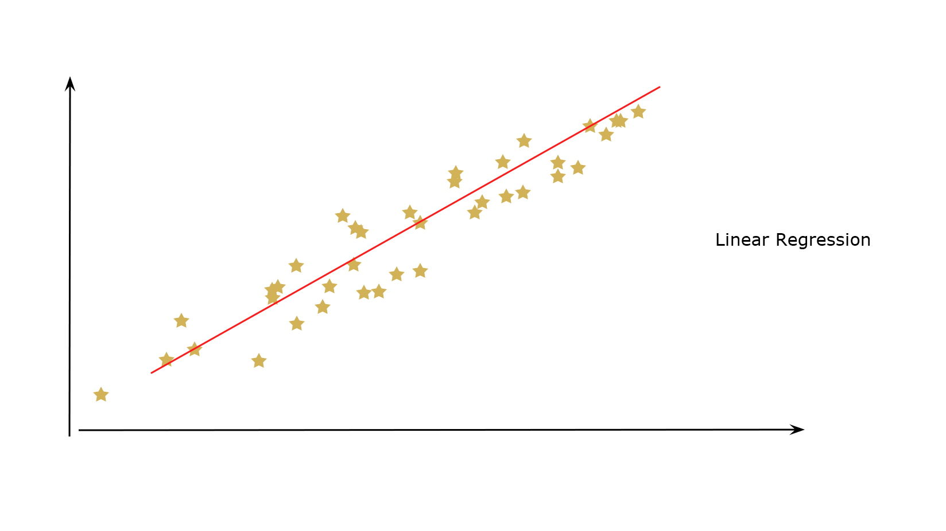

Slide 6
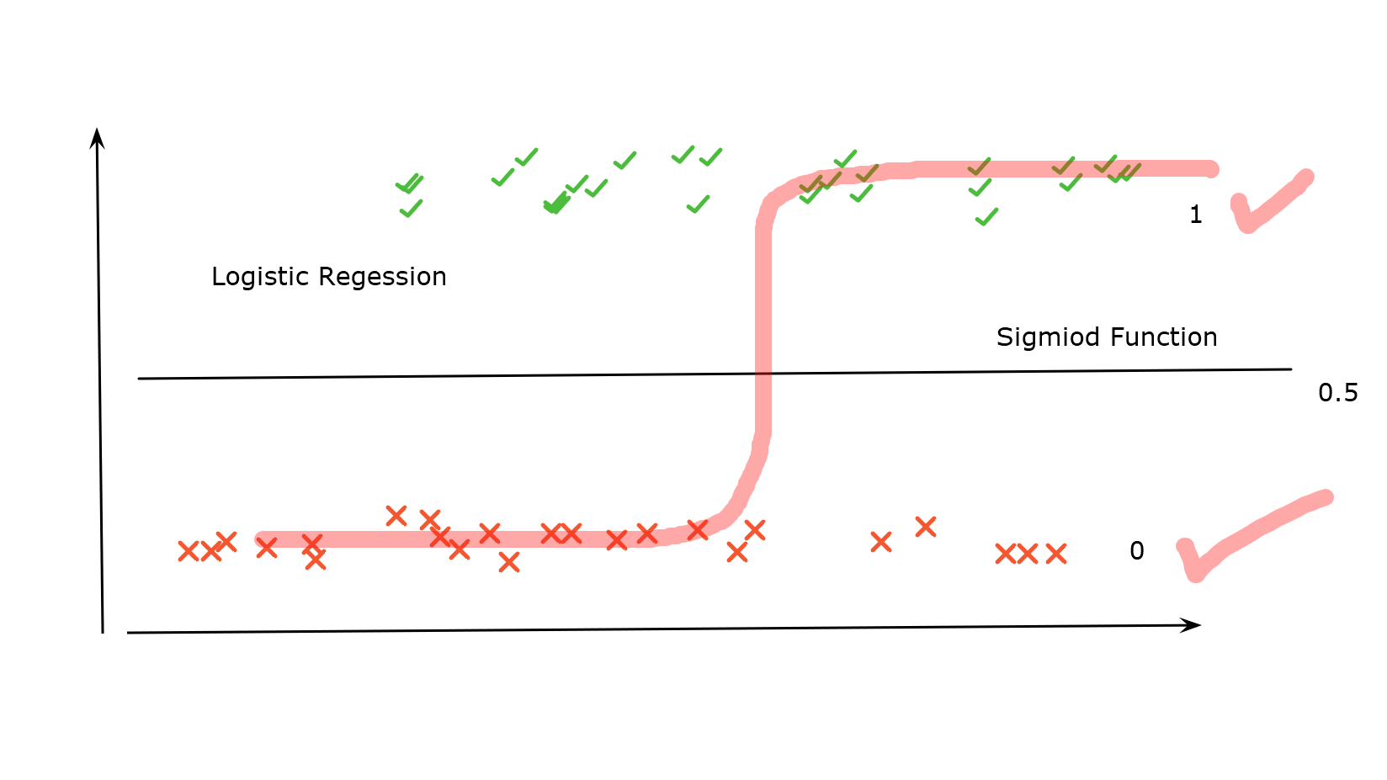

Slide 7
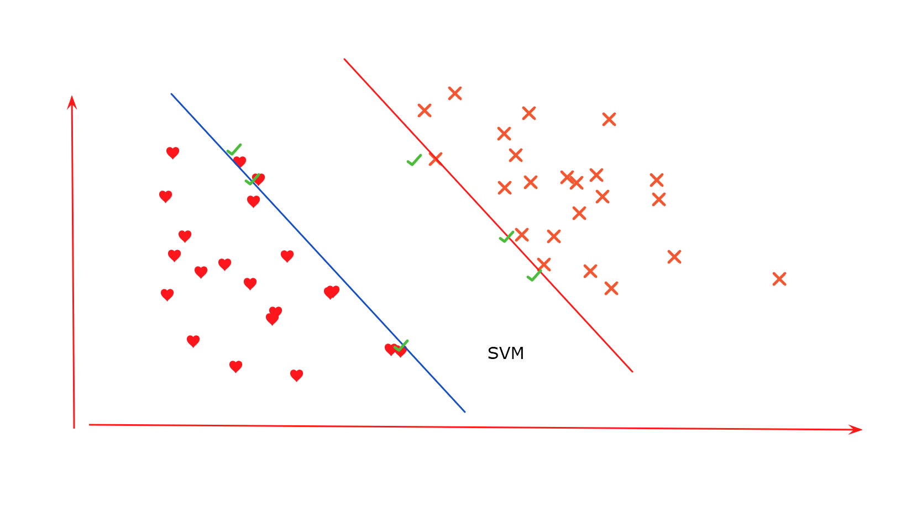

Slide 8
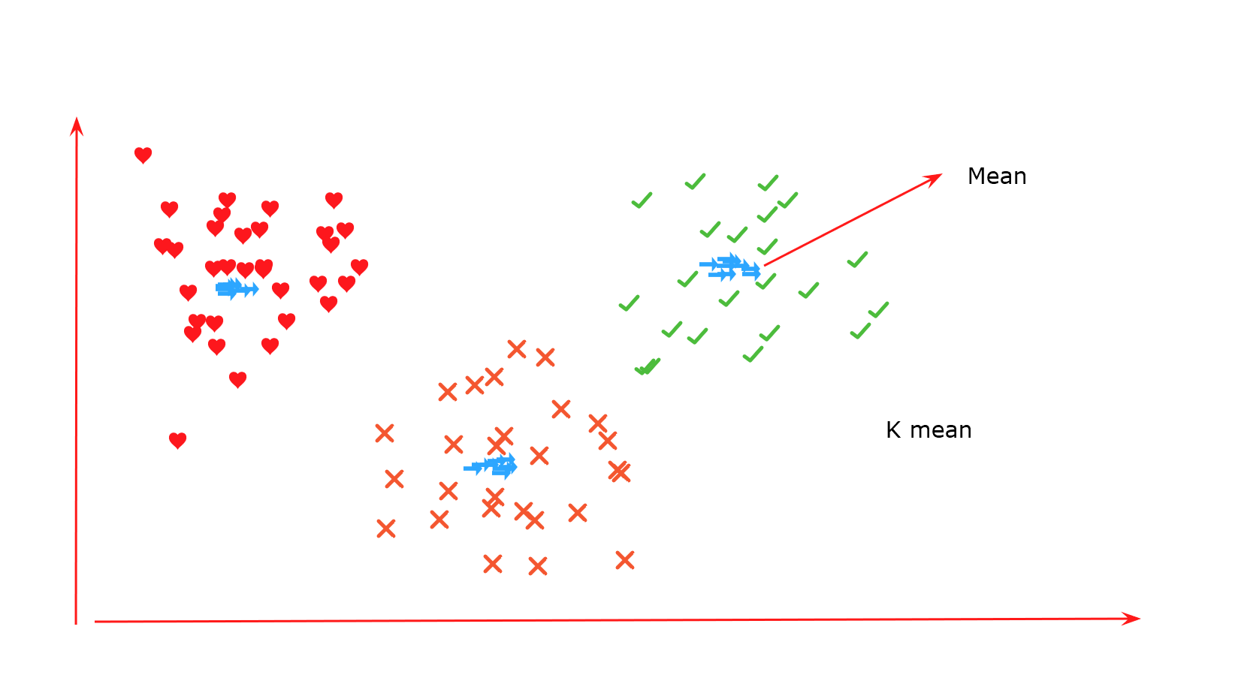

Slide 9
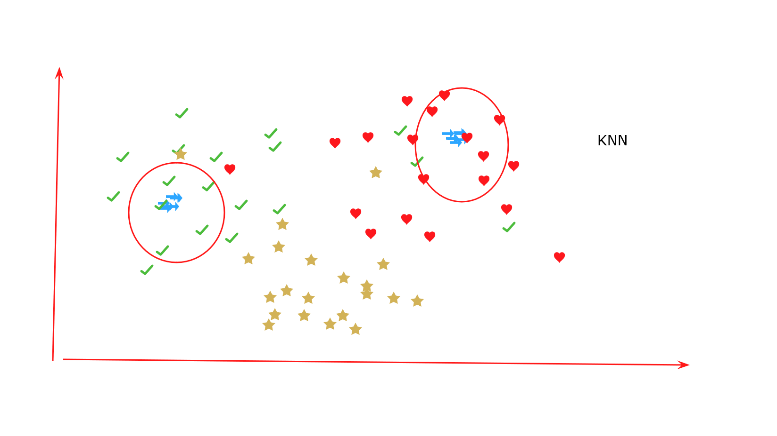

Slide 10
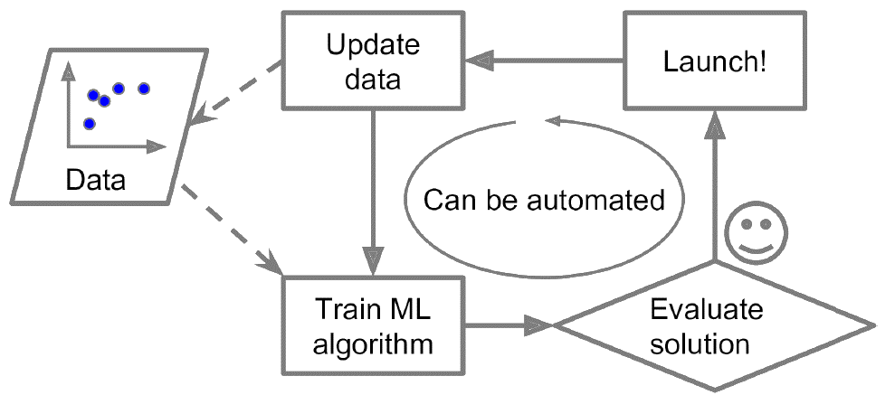

Slide 11
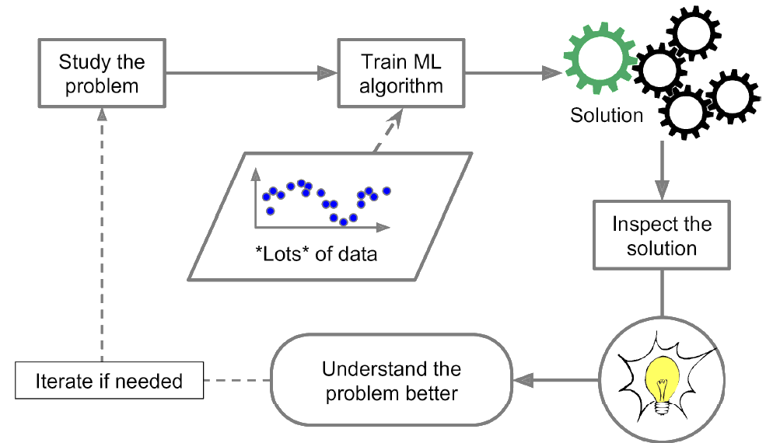

Slide 12
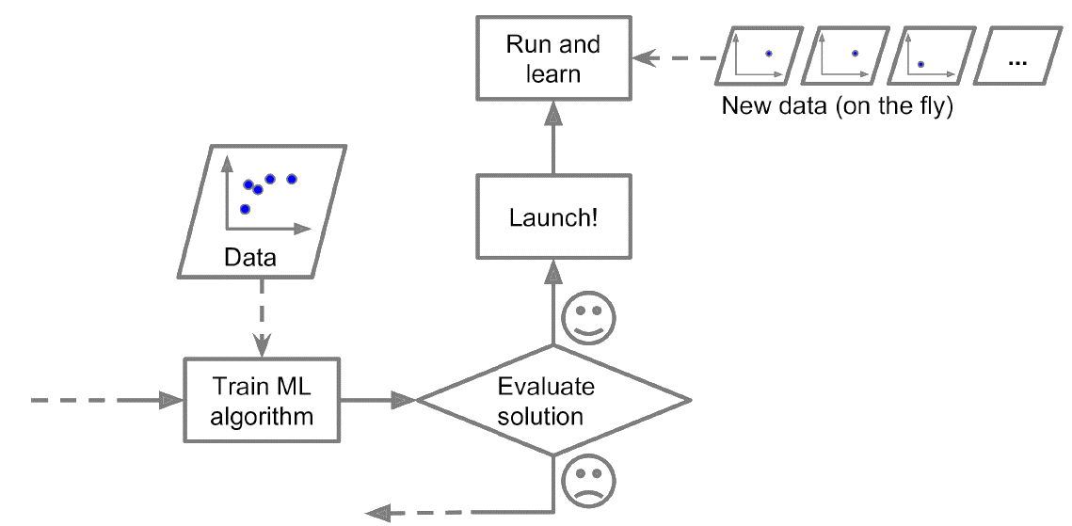

Slide 13
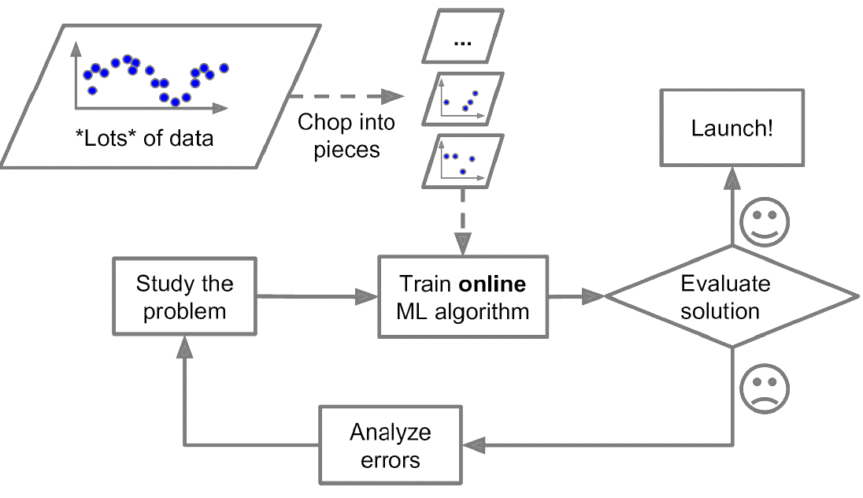

Slide 14
In supervised learning, the training data you feed to the algorithm includes the desiredsolutions, called labels

Slide 15



Ham
labeled training set for supervised learning Instance
Spam
Ham
Spam
Machine
Is
Learning
Ham
Spam
Ham
Spam
Ham

Slide 16
Types of Supervise Learning
k-Nearest Neighbors
Linear Regression
Logistic Regression
Support Vector Machines (SVMs)
Decision Trees and Random Forests

Slide 17
In unsupervised learning, as you might guess, the training data is unlabeled. The system tries to learn without a teacher.

Slide 18























Machine Extract Feature from Data
Based on Feature, Data will be separated and Machine Learn in this Process

Slide 19
Types of Unsupervised Learning
Clustering
Anomaly detection and novelty detection
Visualization and dimensionality reduction
Association rule learning
—K-Means
—DBSCAN
—Hierarchical Cluster Analysis (HCA)
—One-class SVM
—Isolation Forest
—Principal Component Analysis (PCA)
—Apriori
—Eclat

Slide 20
Reinforcement Learning is a very different beast. The learning system, called an agent in this context, can observe the environment, select and perform actions, and get rewards in return (or penalties in the form of negative rewards, must then learn by itself what is the best strategy, called a policy, to get the most reward over time. A policy defines what action the agent should choose when it is in a given situation.

Slide 21
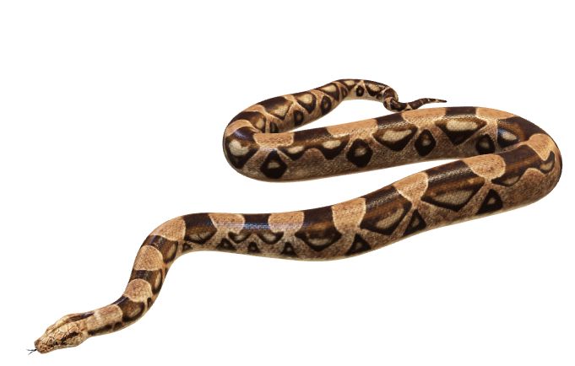



Case 1- If agent reach to single butterfly then reward 1
Case 2- If agent reach to four butterfly then reward 4
Case 3- If agent reach to snake then reward -1
Reward 1
Reward -1
Agent
Reward 4
Note:- Frog is Agent here

